Slide 1
Java Package
Instructor :Prashant Mishra
BIAS Bhimtal

Slide 2
Introduction
Packages are java’s way of grouping a variety of classes and /or interfaces together .
The grouping is done according to the functionality .
Benefits :
The classes contained in the packages of other program can be easily reused.
In packages , classes can be unique compared with classes in other packages . That is two classes in different package can have the same name.
Package provide a way to “hide” classes thus preventing other programs or packages from accessing classes that are meant for internal use only.
Package also provide a way for separating “design” from “coding”;

Slide 3
Java Package
A java package is a group of similar types of classes, interfaces and sub-packages.
Package in java can be categorized in two form, built-in package and user-defined package.
There are many built-in packages such as java, lang, awt, javax, swing, net, io, util, sql etc.

Slide 4
Java API Packages
Java packages are classified in into two types:
1 java API Packages
2 User defined packages
Java API provide a large number of classes grouped into different packages according to functionality

Slide 5
java.lang
java.util
java.io
java.awt
java.net
java.applet
The package are organized in a hierarchical structure .this means the package named java contains the package awt , which inturn contains various classes .

Slide 6
Package
Java
Package containing awt package
awt
Color
Package containing classes
Graphics
Image

Slide 7
Creating Packages
To create a package we must first declare the name of the package using package
keyword followed by a package name .
this must be the first statement in a java source file .
Then we define a class just as we normally define a class.

Slide 8
Declare the package at the beginning of a file using the form
package packagename ;
Define the class that is to be put in the package and declare it public.
Create a sub directory under the directory where the main source file are stored .
Store the listing as the classname.java file in the subdirectory created.
Compile the file this create .class file in the subdirectory.

Slide 9
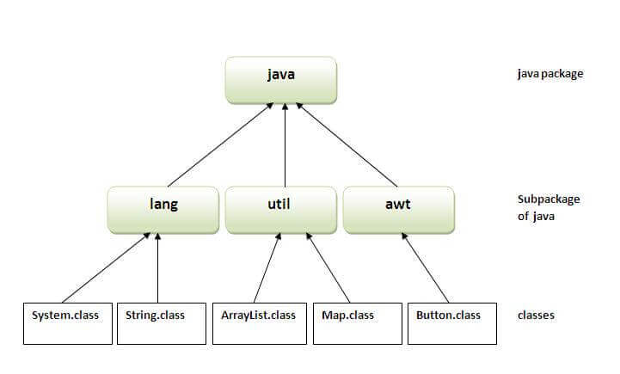
Advantage of Java Package
1) Java package is used to categorize the classes and interfaces so that they can be easily maintained.
2) Java package provides access protection.
3) Java package removes naming collision.

Slide 10
Simple example of java package
//save as Simple.java
package mypack;
public class Simple{
public static void main(String args[]){
System.out.println("Welcome to package");
}
}

Slide 11
Access Modifiers in Java
There are two types of modifiers in Java: access modifiers and non-access modifiers.
The access modifiers in Java specifies the accessibility or scope of a field, method, constructor, or class. We can change the access level of fields, constructors, methods, and class by applying the access modifier on it.

Slide 12
There are four types of Java access modifiers:
Private: The access level of a private modifier is only within the class. It cannot be accessed from outside the class.
Default: The access level of a default modifier is only within the package. It cannot be accessed from outside the package. If you do not specify any access level, it will be the default.
Protected: The access level of a protected modifier is within the package and outside the package through child class. If you do not make the child class, it cannot be accessed from outside the package.
Public: The access level of a public modifier is everywhere. It can be accessed from within the class, outside the class, within the package and outside the package.
There are many non-access modifiers, such as static, abstract, synchronized, native, volatile, transient, etc. Here, we are going to learn the access modifiers only.

Slide 13
Understanding Java Access Modifiers
ccess Modifier | within class | within package | outside package by subclass only | outside package
Private | Y | N | N | N
Default | Y | Y | N | N
Protected | Y | Y | Y | N
Public | Y | Y | Y | Y

Slide 14
1) Private
The private access modifier is accessible only within the class.
Simple example of private access modifier
In this example, we have created two classes A and Simple. A class contains private data member and private method. We are accessing these private members from outside the class, so there is a compile-time error.

Slide 15
class A{
private int data=40;
private void msg(){System.out.println("Hello java");}
}
public class Simple{
public static void main(String args[]){
A obj=new A();
System.out.println(obj.data);//Compile Time Error
obj.msg();//Compile Time Error
}
}

Slide 16
Role of Private Constructor
If you make any class constructor private, you cannot create the instance of that class from outside the class. For example:

Slide 17
2) Default
If you don't use any modifier, it is treated as default by default. The default modifier is accessible only within package. It cannot be accessed from outside the package. It provides more accessibility than private. But, it is more restrictive than protected, and public.
Example of default access modifier
In this example, we have created two packages pack and mypack. We are accessing the A class from outside its package, since A class is not public, so it cannot be accessed from outside the package.

Slide 18
3) Protected
The protected access modifier is accessible within package and outside the package but through inheritance only.
The protected access modifier can be applied on the data member, method and constructor. It can't be applied on the class.
It provides more accessibility than the default modifier.
Example of protected access modifier
In this example, we have created the two packages pack and mypack. The A class of pack package is public, so can be accessed from outside the package. But msg method of this package is declared as protected, so it can be accessed from outside the class only through inheritance.

Slide 19
//save by A.java
package pack;
public class A{
protected void msg(){System.out.println("Hello");}
}
//save by B.java
package mypack;
import pack.*;
class B extends A{
public static void main(String args[]){
B obj = new B();
obj.msg();
}
}

Slide 20
4) Public
he public access modifier is accessible everywhere. It has the widest scope among all other modifiers.
Example of public access modifier
//save by A.java
package pack;
public class A{
public void msg(){System.out.println("Hello");}
}
//save by B.java
package mypack;
import pack.*;
class B{
public static void main(String args[]){
A obj = new A();
obj.msg();
}
}
T

Slide 21
Java Access Modifiers with Method Overriding
If you are overriding any method, overridden method (i.e. declared in subclass) must not be more restrictive.
class A{
protected void msg(){System.out.println("Hello java");}
}
public class Simple extends A{
void msg(){System.out.println("Hello java");}//C.T.Error
public static void main(String args[]){
Simple obj=new Simple();
obj.msg();
}
}

